Slide 1
MECE 6397 – MACHINE LEARNING CHANGES IN TESTING DATA AND THEIR IMPLICATIONS ON THE CLASSIFICATION MODEL ROBUSTNESS
BY –HIMANSHU BADERA
PSID - 2090998

Slide 2
INTRODUCTION
X-Ray
COVID-19
Normal
Tuberculosis
Machine Learning
Data Augmentation
DenseNet
CNN
Results
Accuracy
Pneumonia

Slide 3
Datasets
Original
Data Augmentation
Blended
Data
Augmentation
Original
Gaussian Blur
Tinted
Lens Flare
Gaussian Blur/Tinted
Gaussian/ Lens Flare
Tinted/ Lens Flare
All augmented Images
Normal
COVID-19
Pneumonia
Tuberculosis
Gaussian Blur
Tinted
Lens Flare

Slide 4
Discussion
Used Photo Editing Software (GIMP)
X-ray scans were down sampled and downsized to 128x128x3 pixel dimensions to improve model generalization and processing speed.
Created 7 different categories of images
ReLU Activation function was used
Softmax Activation function was used

Slide 5
Discussion
Dataset Used
Set | Images
Gaussian Blur | 117
Tinted Images | 173
Lens Flare | 100
Lens Flare and Gaussian Blur | 213
Lens Flare and Tinted Images | 272
Tinted Images and Gaussian Blur | 287
All Changed Images | 389
Original Dataset | 7097

Slide 6
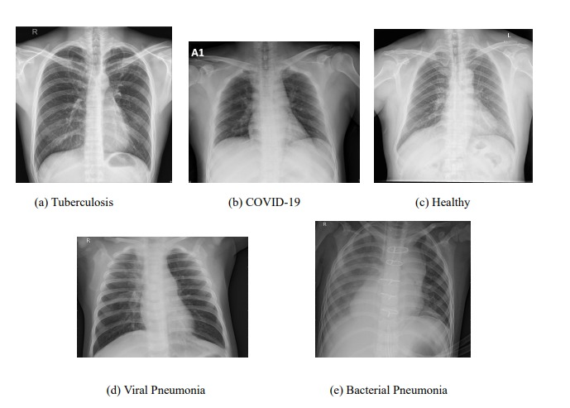
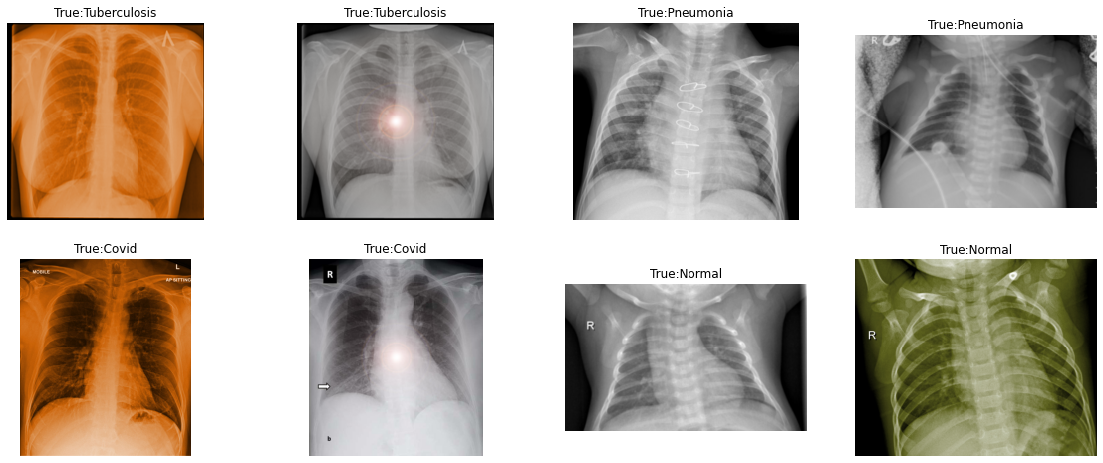
Images after Preprocessing
Original X-Rays
All changes

Slide 7
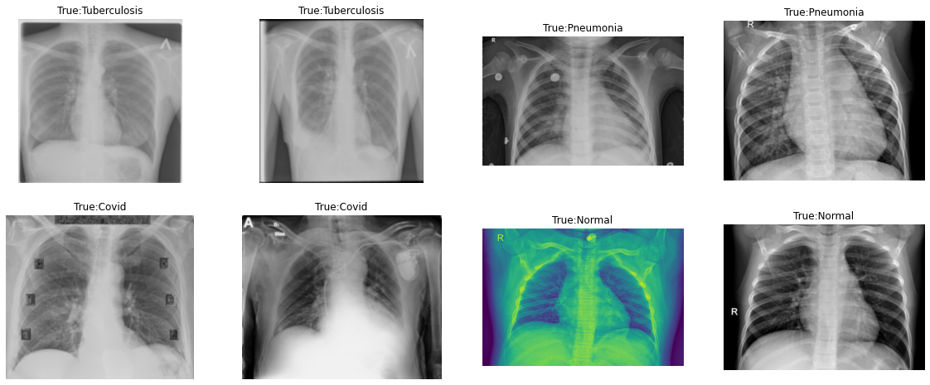
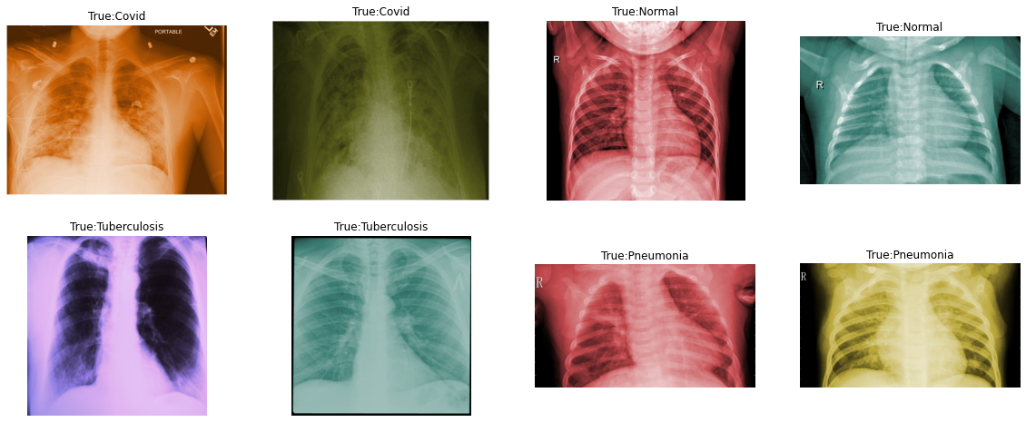
Gaussian Blur
Tinted Blur

Slide 8
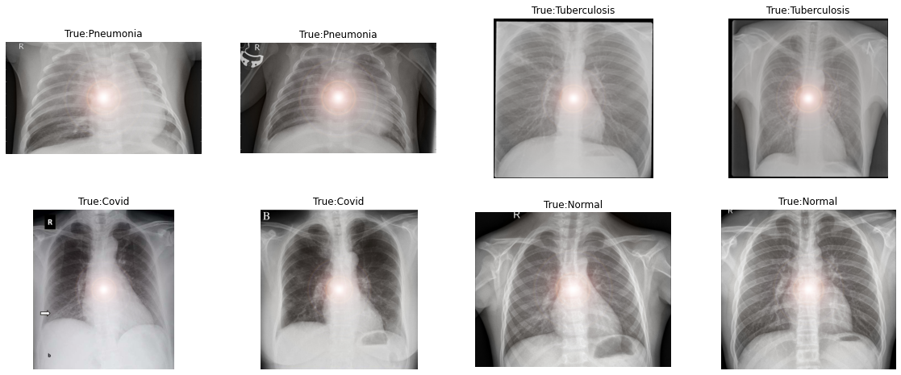
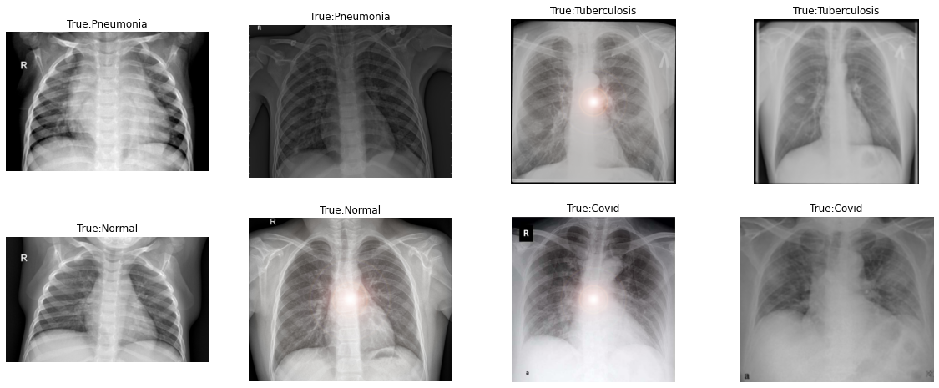
Lensflare Blur
Lensflare and Gaussian Blur

Slide 9
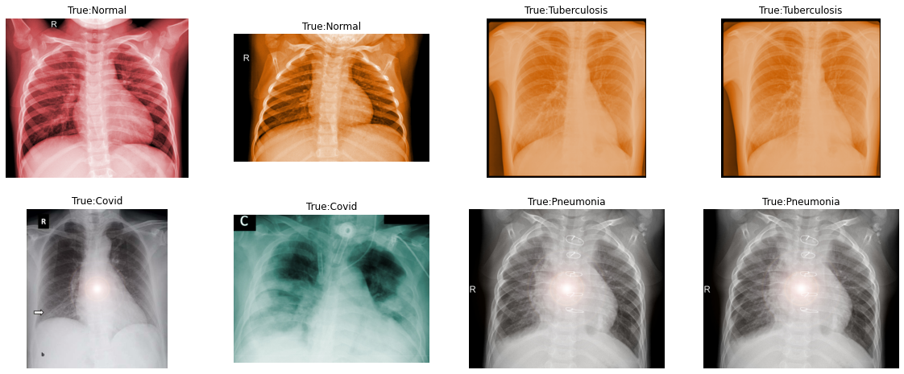
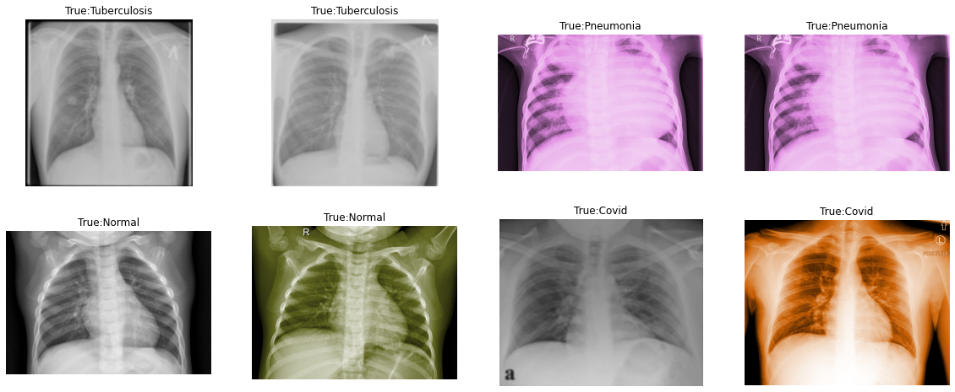
Lensflare and Tinted Blur
Tinted and Gaussian Blur

Slide 10
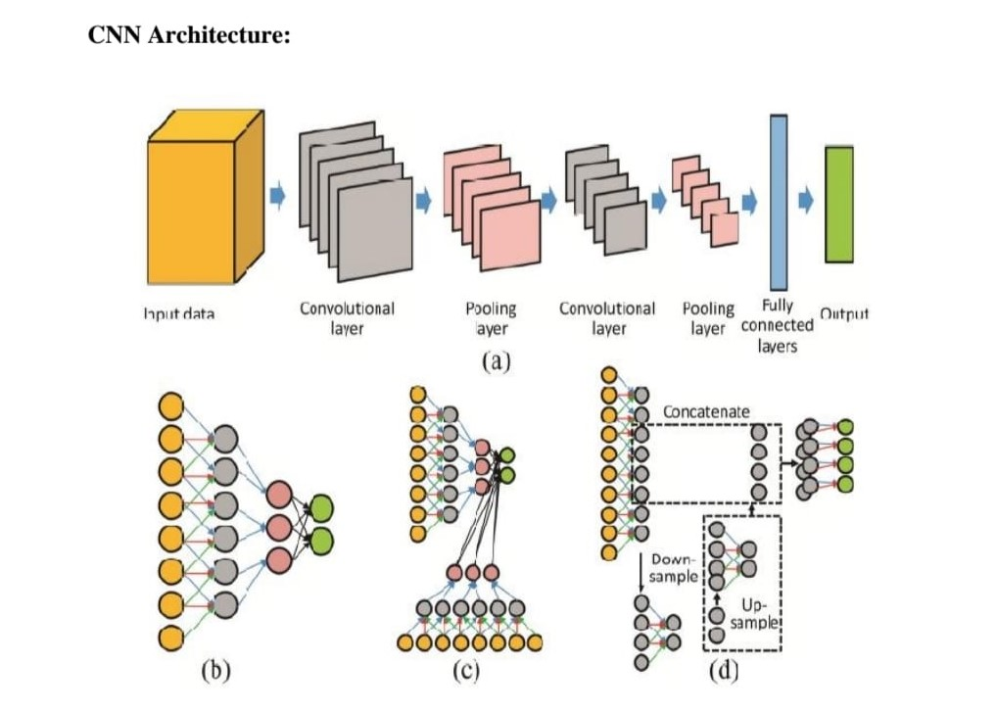
Methodology (CNN)
Resize the images to 150 by 150 pixels (GIMP)
Used 6 layers of alternating sequence of convolutional layers
The first 2D convolution layer comprise filter of size 7x7 and stride of 2
Second layer comprise filter of size 5x5 and stride of 2.

Slide 11
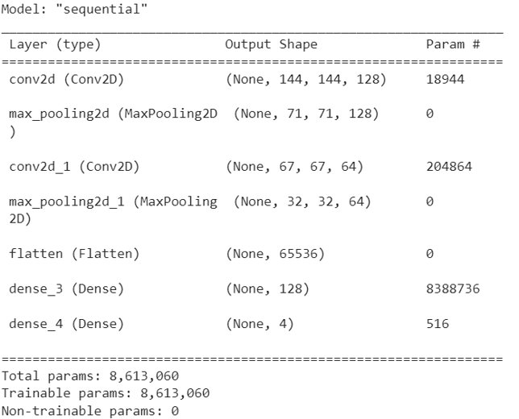
Methodology (CNN)
Varying number of channels are used – 128, 64.
4×4 max pooling layers with stride of 2 are used.
reLU activation function is used.
A SoftMax activation function is used for the final layer.

Slide 12
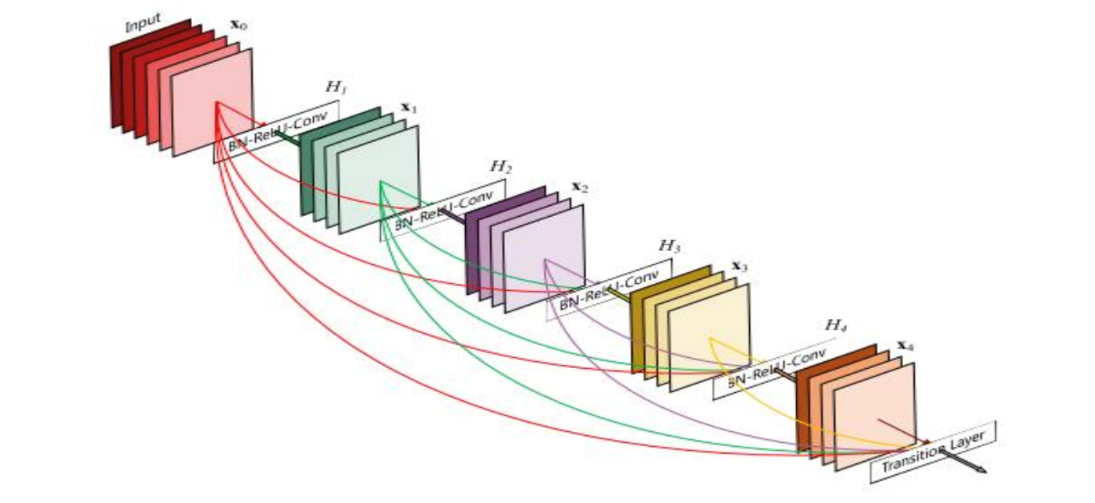
Methodology
DenseNet:
3 convolutional layers with ReLu activation functions
Probability activated by softmax
Loss function: categorical crossentropy
Optimizer: adam
Learning rate: 0.000002

Slide 13
Results
DenseNet |  | Gaussian | Tinted | Lens Flare | Gaussian/ Lens Flare | Lens Flare/ Tinted | Gaussian/Tinted | ALL | Original
 | Validation Accuracy | 0.4167 | 0.3429 | 0.3 | 0.45 | 0.7037 | 0.6964 | 0.5358 | 0.7082
 | Accuracy | 0.9892 | 0.8043 | 1 | 0.9769 | 0.9128 | 0.9307 | 0.7395 | 0.9331
CNN
 | Validation Accuracy | 0.6667 | 0.7429 | 0.6 | 0.8 | 0.8148 | 0.8571 | 0.833 | 0.8431
 | Accuracy | 0.5376 | 0.8623 | 0.9 | 0.8902 | 0.7202 | 0.8312 | 0.8842 | 0.95

Slide 14
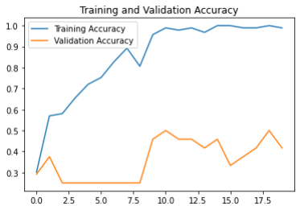
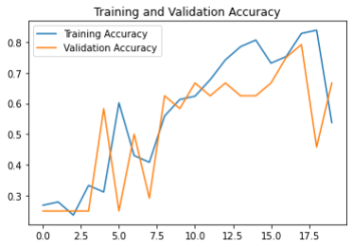
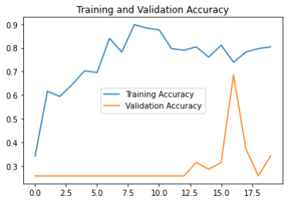
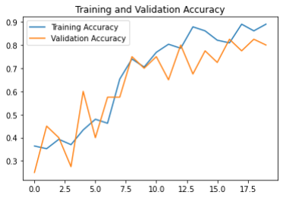
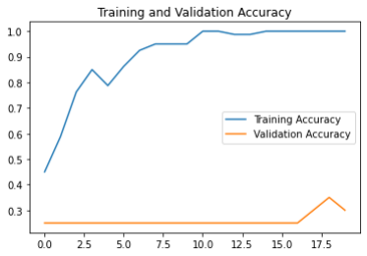
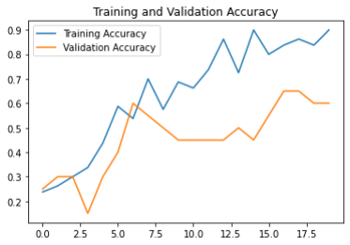
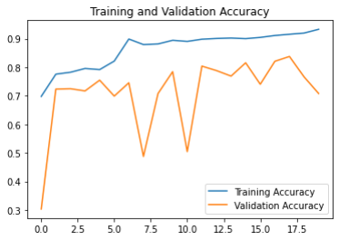
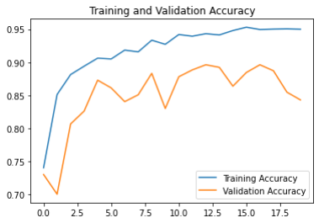
Observation
DenseNet
CNN
Gaussian
Tinted
Lens Flare
Original

Slide 15
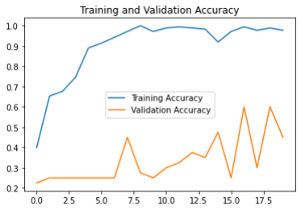

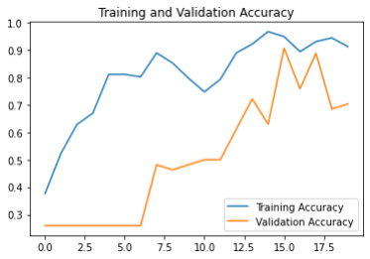
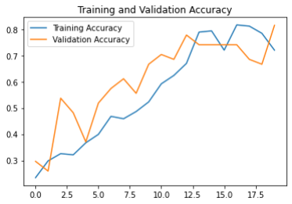
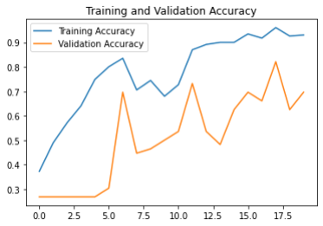
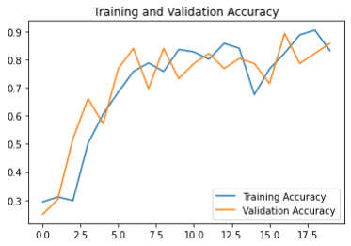
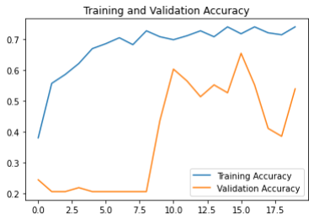
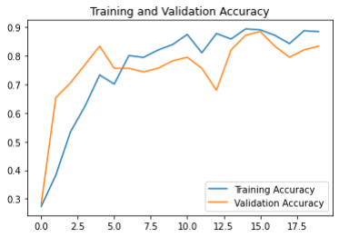
Observation
DenseNet
CNN
Lens Flare & Gaussian Blur
Lens Flare & Tinted Images
Tinted Images & Gaussian Blur
All

Slide 16
Conclusion
CNN model- Higher Accuracy on Augmented Datasets
DenseNET model- Higher Accuracy on Original Dataset
DenseNET model- Overfitting
This research offered an alternative COVID-19 screening method based on identifying specific features in chest X-Ray pictures.
If successful, it will provide medical practitioners with assistive intelligence to help them deal with the severity of the pandemic.

Slide 17
Thank You
Any Questions?

